Slide 1

Data-Driven Analysis of Incident Management and Service Desk Operations”

Slide 2
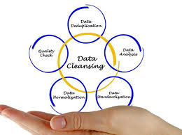
What is Data Cleaning? Detecting and correcting errors, inconsistencies, and missing values in data. Ensures dataset is accurate, complete, and ready for analysis. Importance of Data Cleaning : Accuracy – Clean data gives correct and reliable results Efficiency – Saves time and makes analysis easier. Better Decisions – High-quality data leads to better business decisions.

Slide 3


Slide 4
PANDAS
Pandas is a Python library used for data analysis and data manipulation.
It helps to store, clean, transform, and analyze data easily.
Supports operations like filtering, grouping, merging, sorting, and handling missing values.
Widely used in Data Science, Machine Learning, and Data Analytics
In short: Pandas = Easy tool to handle and analyze data in Python (like Excel in coding).

Slide 5
Common Data Cleaning Tasks in pandas
Renaming Columns – Give meaningful and consistent names.
Formatting Dates – Convert to proper datetime format.
Handling Inconsistent Data – Fix spelling errors or category mismatches.
Creating / Modifying Columns – Add new calculated fields (e.g., Resolution_Time).
Sorting & Resetting Index – Organize dataset properly.
Handling Missing Values – Fill with mean, median, mode or remove rows/columns.
Removing Duplicates – Avoid repeated records.
Standardizing Data – Convert text to lowercase/uppercase, remove spaces.
Correcting Data Types – Change columns to proper type (int, float, datetime).

Slide 6

INTRODUCTION
Data-Driven Analysis of Incident Management and Service Desk Operation
In IT companies, daily issues like system, network, or login problems are recorded through a ticketing system.
This dataset contains those ticket details, and by cleaning the data, we can clearly understand the performance of the IT helpdesk.

Slide 7
COLUMN INCLUDED
TICKET_ID – Unique number assigned to each support ticket.
EMPLOYEE_ID – ID of the employee who reported the issue.
DEPARTMENT – Department of the employee (e.g., IT, HR, Finance).
ISSUE TYPE – Category of problem (e.g., Login issue, Software bug).
PRIORITY – Urgency level (High, Medium, Low).
REPORTED DATE – Date when the issue was reported.
RESOLVED DATE – Date when the issue was resolved.
RESOLUTION TIME HOURS – Total time taken to resolve (in hours).
STATUS – Current status of the ticket (Open, In-progress, Closed).
CUSTOMER RATING – Feedback rating given by employee/customer.

Slide 8
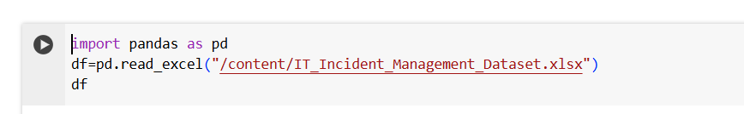
IMPORT THE DATASET

Slide 9

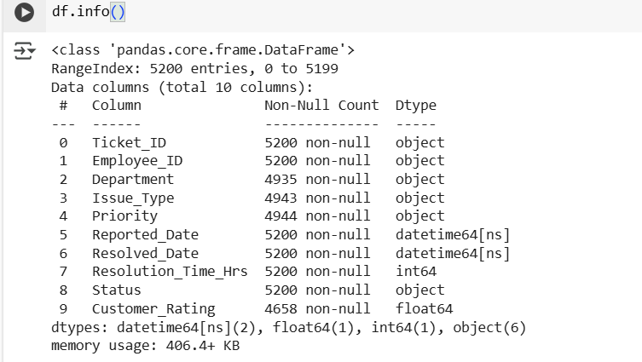
EXPLORE THE DATA

Slide 10
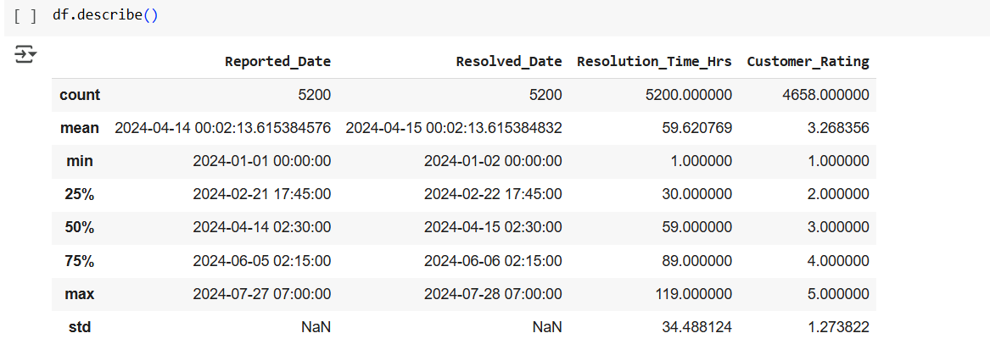

Slide 11
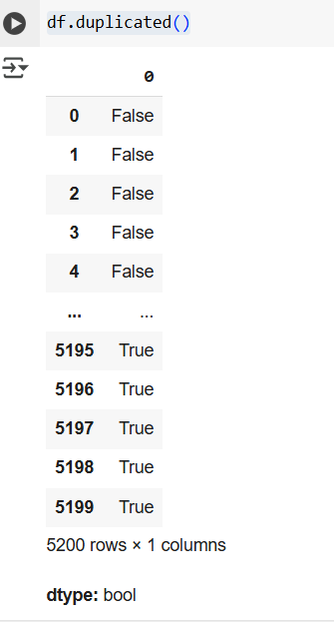

FINDING DUPLICATE DATA

Slide 12
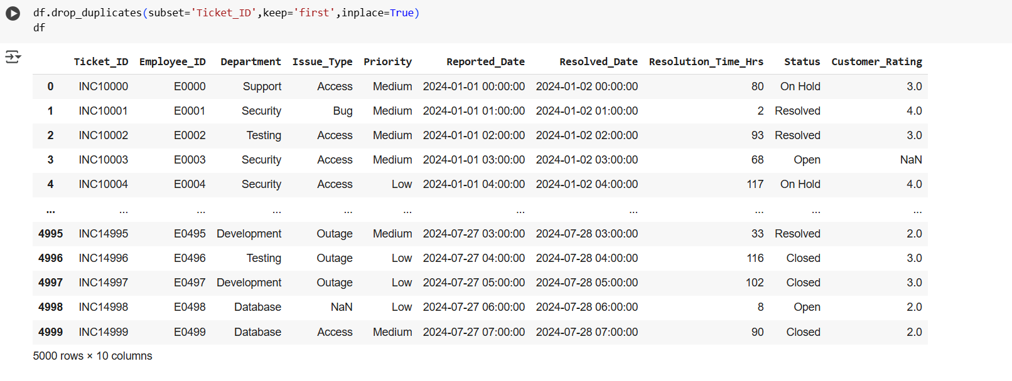
REMOVE DUPLICATES

Slide 13
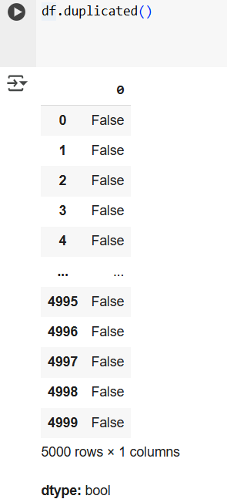

Slide 14
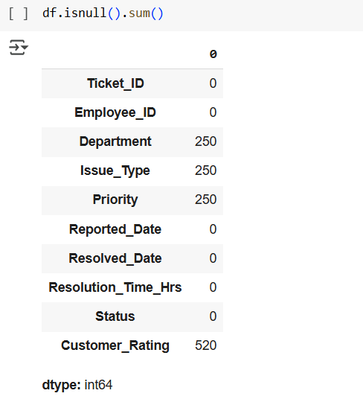
DETECTING MISSING VALUE

Slide 15

HANDLING MISSING VALUES

Slide 16
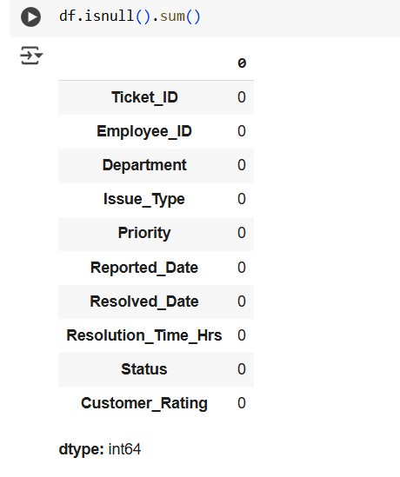

Slide 17
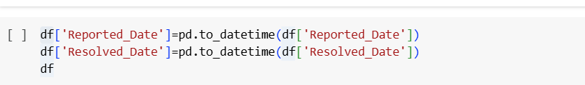
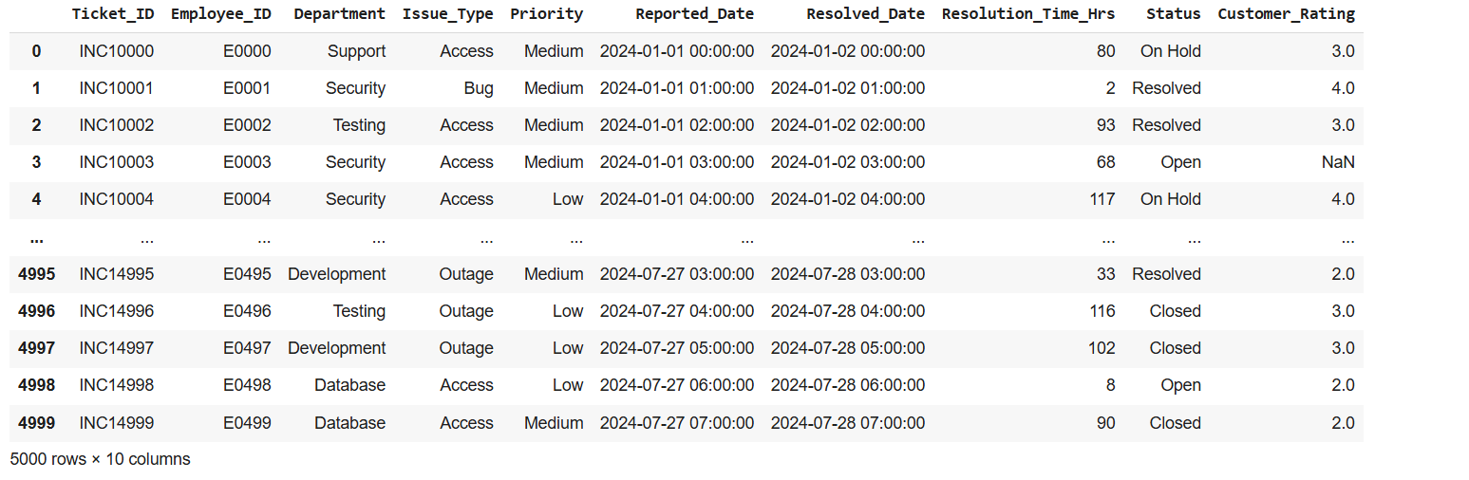
CONVERT THE COLUMN TO DATE TIME

Slide 18
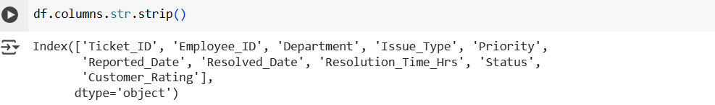
WHITESPACE REMOVAL
REPLACEING INCONSISTANT CASING

Slide 19


UPDATE COLUMN NAME
SORTING BY RESOLUTION TIME

Slide 20
CONCLUSION
Data cleaning is an important step that removes errors, duplicates, and inconsistencies from the dataset. It also handles missing or incorrect values, ensuring that the data is accurate and reliable. By preparing the data properly, we can make better and more informed decisions based on the results.
Pandas is a powerful python library that helps in data cleaning, manipulation, and analysis in a simple and efficient way.

Slide 21


Slide 22
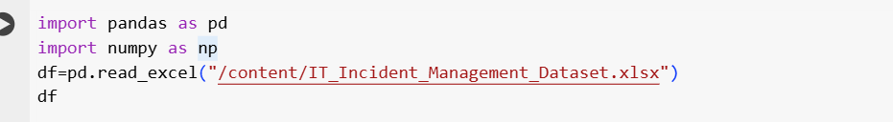
What is Numpy? NumPy (Numerical Python) is a Python library used for fast numerical calculations. It provides arrays, mathematical functions, and statistics for handling large datasets. Mostly used for data analysis, scientific computing, and machine learning.
IMPORT THE DATASET

Slide 23
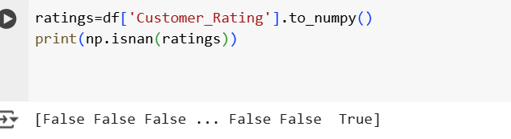
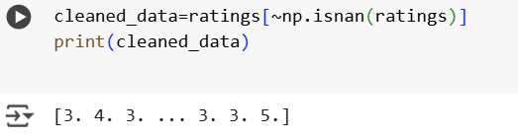
DETECTING MISSING VALUE
HANDLING MISSING VALUES

Slide 24
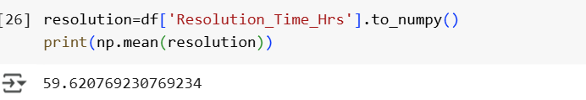
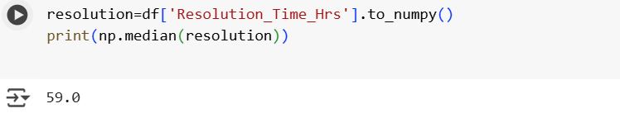
MATHEMATICAL AND STATISTICAL OPERATIONS

Slide 25
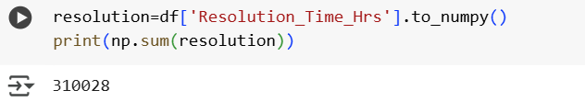
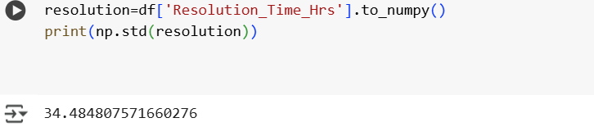

Slide 26
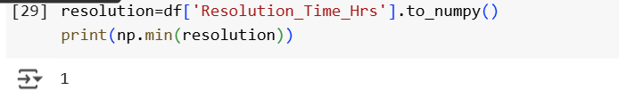
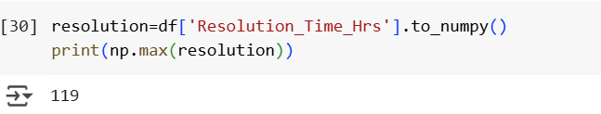

Slide 27
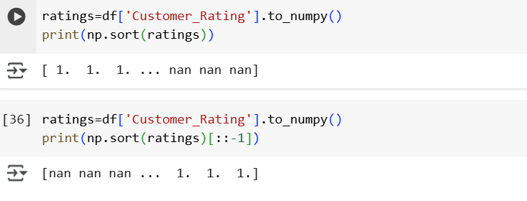
SORTING IN NUMPY

Slide 28
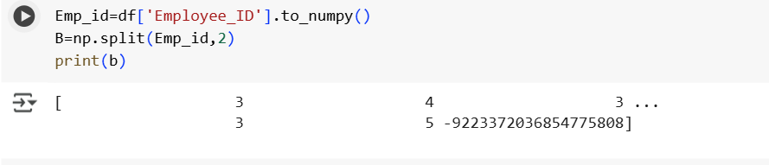
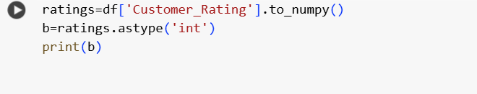
SPLITTING
AS TYPE:

Slide 29
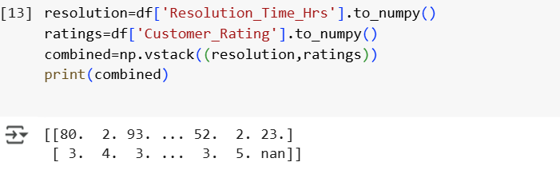
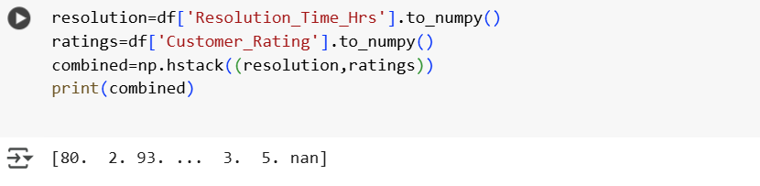
JOINING:

Slide 30
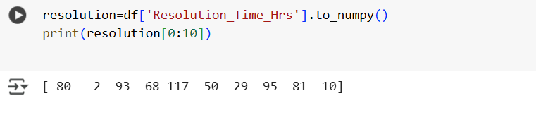
SLICING

Slide 31
CONCLUSION
NumPy is a powerful Python library that provides fast and efficient tools for numerical computing.
It simplifies working with multi-dimensional arrays, mathematical functions, and large datasets.
In short, it makes complex numerical operations easier, faster, and more reliable.

Slide 32


Slide 33
MATPLOT LIBRARY:
Matplotlib is a Python library used for data visualization.
It helps to create graphs, charts, and plots to understand data better.
Common plots include:
Line Chart
Bar Chart
Pie Chart
Scatter Plot
Histogram
In short: Matplotlib = Tool to turn data into visuals (like graphs and charts).

Slide 34
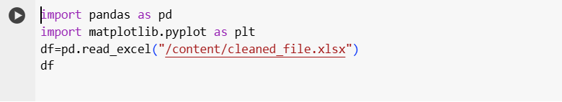
IMPORT THE DATASET

Slide 35
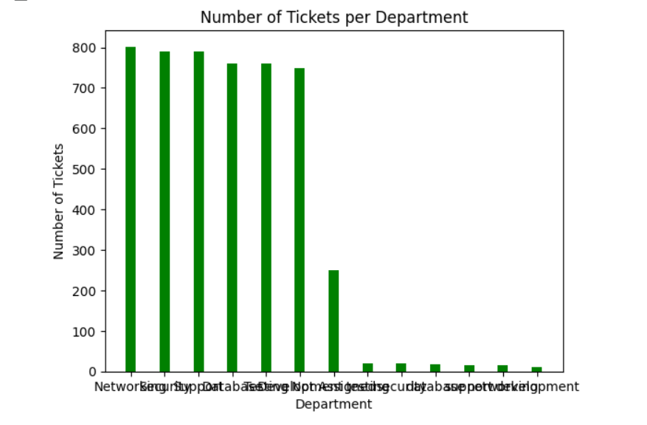
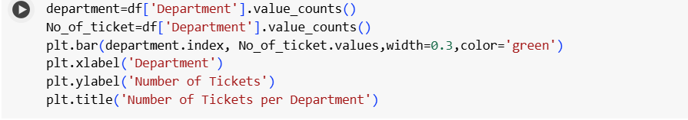
BAR CHART

Slide 36
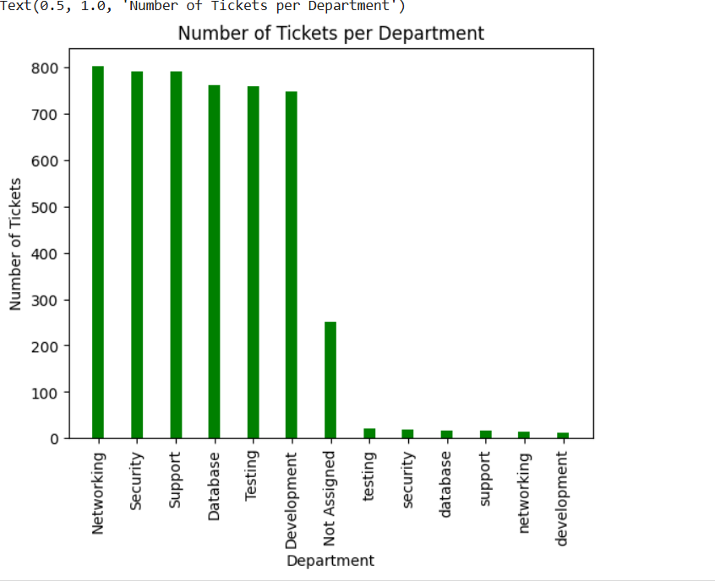
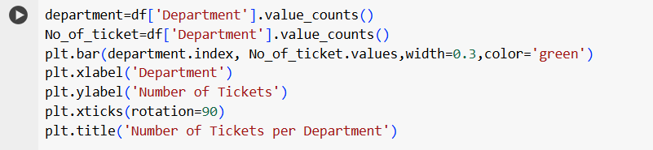

Slide 37
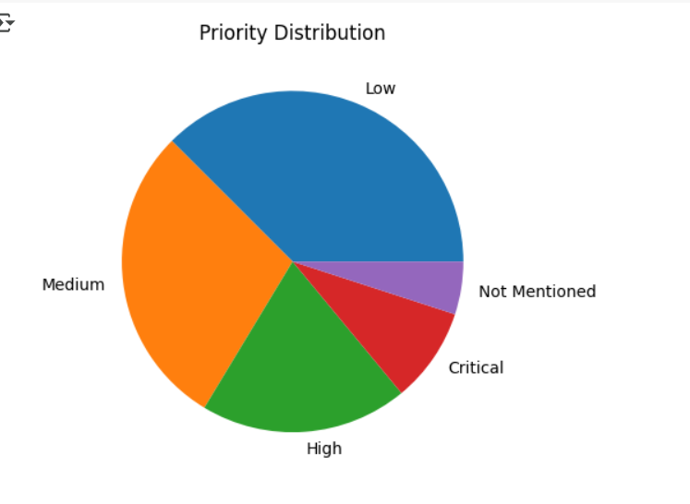
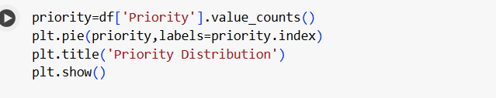
PIE CHART

Slide 38
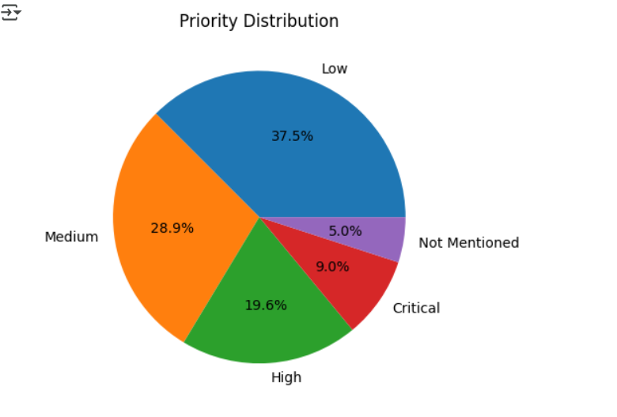
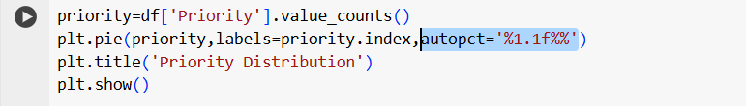

Slide 39
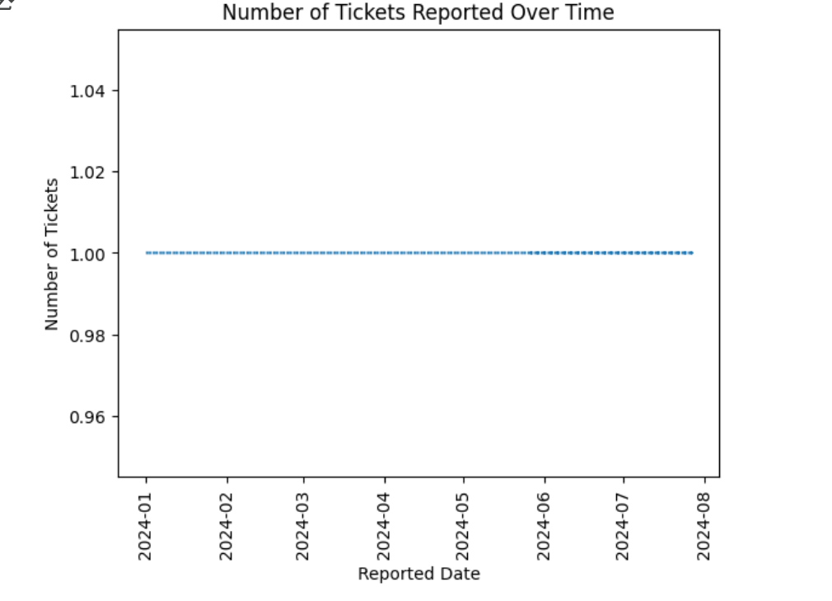
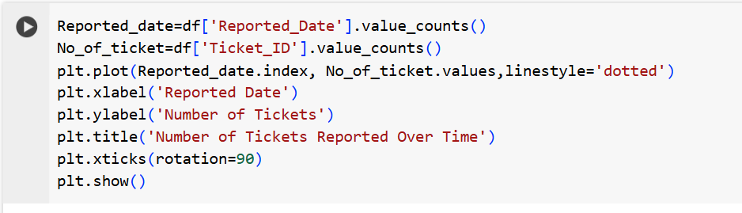
LINE CHART

Slide 40
CONCLUSION
Matplotlib is a powerful Python library for creating different types of charts and visualizations, making data easy to understand and present

